Slide 1


APPLICATION FOR BLOOD BANK MANAGEMENT SYSTEM
Group 2
Jwalit Shah
Use Case Presentation
12/07/2022

Slide 2
Problem Definition
With the advent of Technology, the world is taking rapid strides in the Healthcare sector to provide efficient and cost-effective solutions to the existing problems.
Blood banks often participate in the process of collecting bloods and other procedures such as managing stocks, approving blood, approving blood requests, and updating donor information. Furthermore, they collaborate with the hospitals and the donors to provide the collected blood to the hospitals as per their requirement.
The COVID-19 pandemic in a way, gave a harsh reality check to the existing Medicare system in India. The prolonged issues of many patients in backlog due to inadequate number of beds in the hospital got highlighted during the second wave of COVID-19 when numerous people across the country suffered as they could not get the desired blood in time for their respective treatments.
Hence, Blood banks maintain an extensive network of blood donors and recipients to fulfill the medical requirement when the need arises.
To ensure quick and easy management for the same, it is imperative to design a web-based application which stores, processes, retrieves and analyses the information concerned with administrative and inventory management involved in the entire chain of events.
The primary purpose of this application is to simplify and automate the process of searching blood along with minimizing time and cost of labor invested in accessing and storing the vast information.

Slide 3
Model Requirements
Every region with a zip code has at least one blood bank available.
Every region with a zip code has at least one hospital available.
A donor can donate blood only once in a span of 3 months.
If a donor is suffering from a chronic disease, which can make blood incompatible for others, then the donor is not allowed to donate blood.
A donor is deemed ineligible to donate blood if he/she has smoked or consumed alcohol in the last 2 weeks.
The Universal Donor (O group) can donate red blood cells to any other blood group.
The Universal recipient (AB group) can receive red blood cells from any other blood group.
Excluding the Universal donors and Universal recipients’ category, recipients from all other bloodcategories need the donors to be of the same blood group (with sign) as themselves.

Slide 4


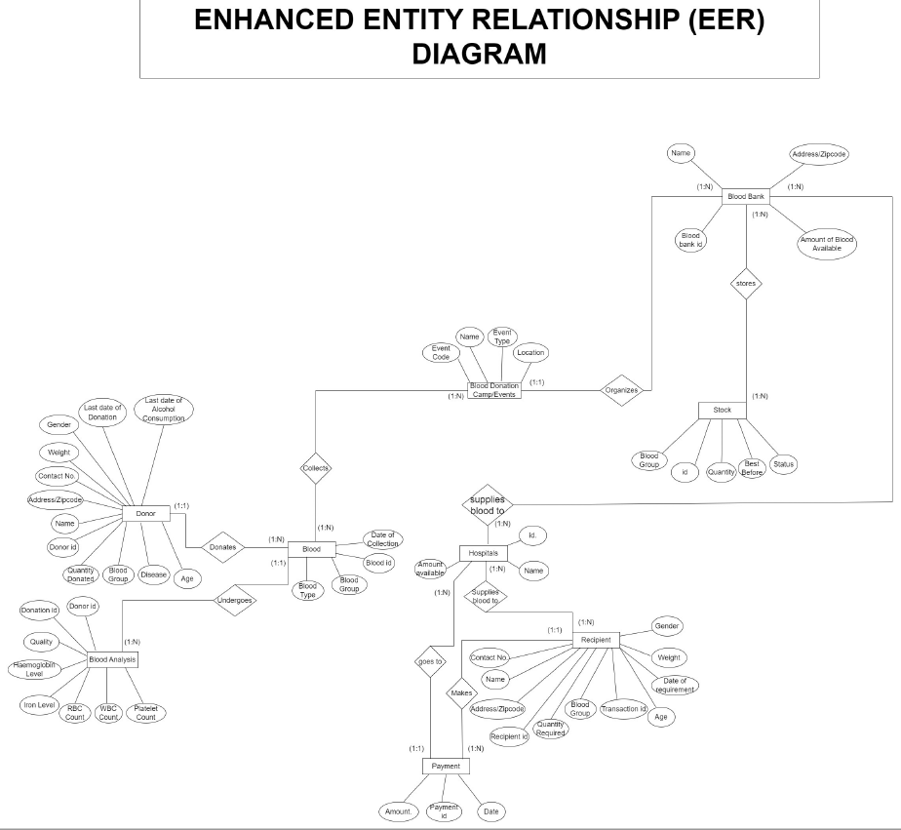
EER Diagram

Slide 5
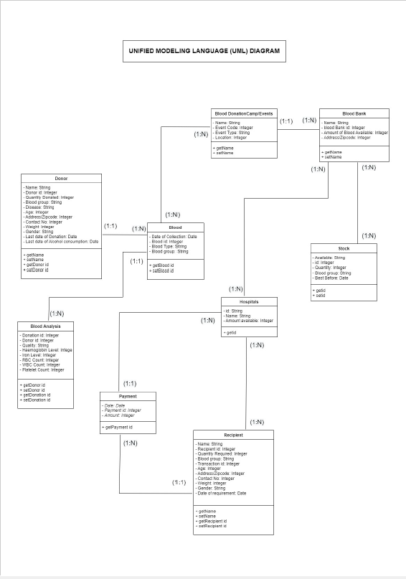
UML Class Diagram

Slide 6
Relation Model (Logical Model)
Donor (Donor_id, first_Name, Last_Name, Zip code, Gender, Weight, Last_donation_date, Last_alcohol _consumption, Quantity_ donated, Donor_ Blood _Group, Disease, Age)
Donor: Donor id in relation to Donor: NULL not allowed, on delete/update cascade.
Analysis (Donation id, Donor id, Quality, Haemoglobin Level, Iron Level, RBC Count, WBC Count, Platelet Count, Blood id)
Here, Donation id is the primary key.
Donor: Donor id in relation to Donor: NULL not allowed, on delete/update cascade.
Blood (Blood Type, Blood Group, Collection date, Blood id, Donor id, Event Code)
Here, Blood id is the primary key.
Donor: Donor id in relation to Donor: NULL not allowed, on delete/update cascade.
Events: Event Code in relation to Events: NULL not allowed, on delete/update cascade.
Blood banks: Blood bank id in relation to Blood bank: NULL not allowed, on delete/update cascade.
Events (Event Code, Event Name, Event Type, Location, Blood bank id)
Here, Event Code is the primary key.
Events: Event Code in relation to Events: NULL not allowed, on delete/update cascade.
Blood banks: Blood bank id in relation to Blood bank: NULL not allowed, on delete/update cascade.

Slide 7
Relation Model (Logical Model)
Hospitals (Hospital ID, Hospital name, Amount available, Blood bank id, Payment id, recipient id)
Here, Hospital ID is the primary key.
Blood bank: Blood bank id in relation to Blood bank: NULL not allowed, on delete/update cascade.
Payments (Payment id, Amount, Payment date, Recipient id)
Here, Payment id is the primary key.
Recipient: Recipient id in relation to Recipient: NULL not allowed, on delete/update cascade.
Recipient (Recipient id, Transaction id, first_Name, Last_Name, Zip code, Gender, Weight, Date of requirements, Quantity required, Blood Group, Age, Contact No)
Here, Recipient id and Transaction id are the primary keys
Blood Bank (Blood bank id, Blood bank name , Zip code, Quantity Available)
Blood bank: Blood bank id in relation to Blood bank: NULL not allowed, on delete/update cascade.
Stocks ( Stock id, Blood Group, Blood available, Status, best before, Blood bank id )
Here, Blood Group is the primary key.

Slide 8
Next Steps
MySQL Implementation
NoSQL Implementation
Access to Database via Python

Slide 9

THANK YOU

